Slide 1
Ibot
Young Liu, Yun Ma, Xiao Liang, Xuzhou Yin

Slide 2
Functionality show cases
Create issue on Jira
Search issue on Jira
Assign issue to user
Change issue statue (From “To Do‘ to “Done” for instance)
See issues assigned to a certain user
Refactor code to remove redundency
Add more info(priority, comment) to the issue created
Notes:
Xiao

Slide 3
Merits of Typescript
Compile time type check
Interfaces for defining type of JSON requests and responses
Promises!
async and await make asynchronous programming so much easier

Slide 4
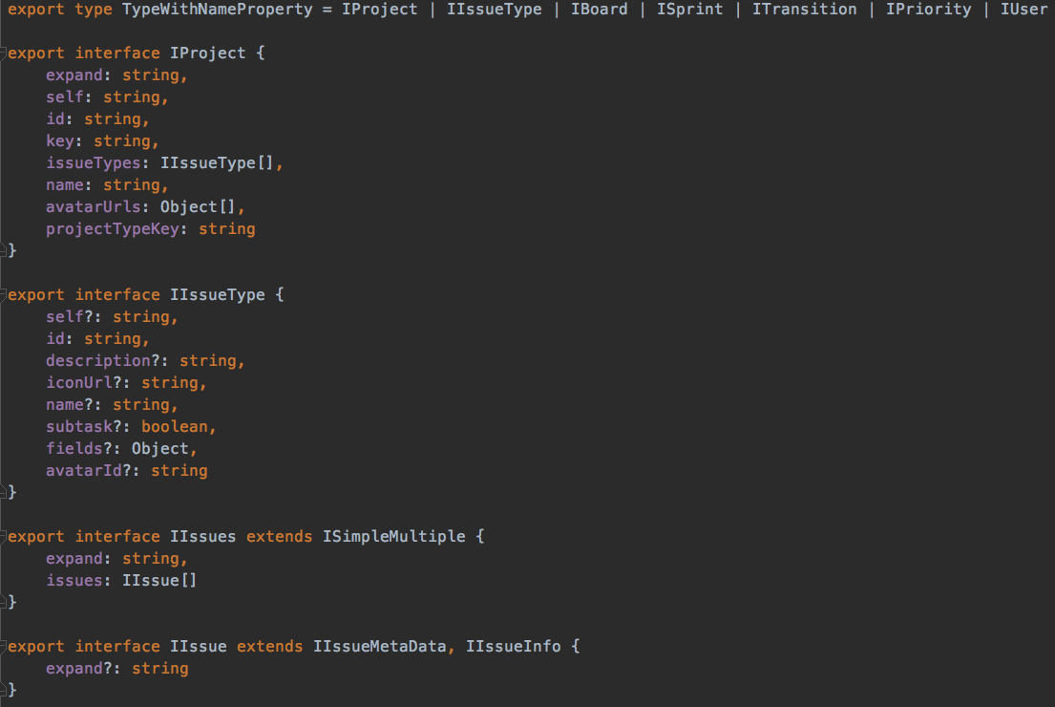
Types!

Slide 5
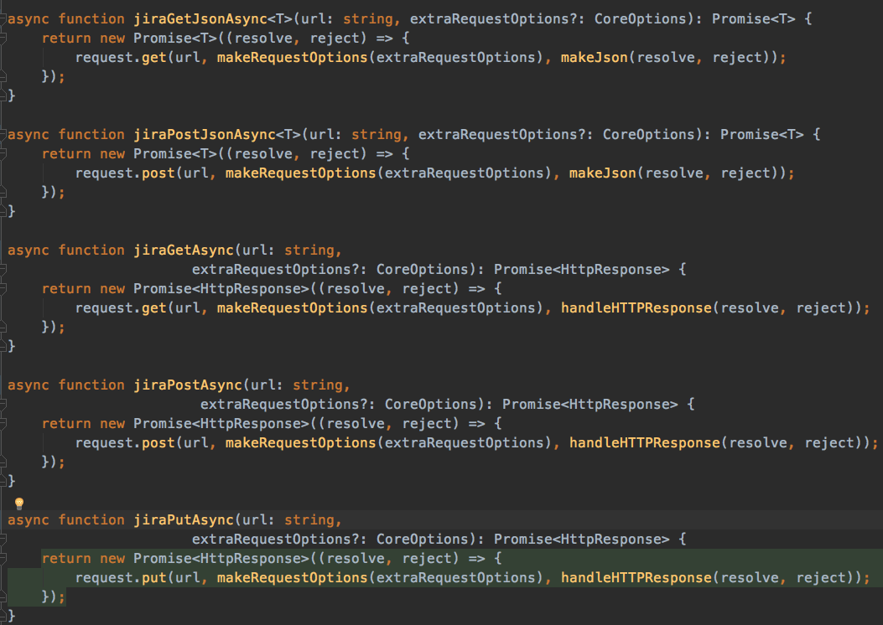
Types!

Slide 6
Demo
Notes:
Xuzhou

Slide 7
Test
Respond when user joins
List abilities to user
create a task
move a task
burndown rate
Confirm user’s command
ensure if user want to create a task with its name
Reply message to inform user
tell user after a task is created
Answer user’s questions
Data: burndown rate
‘Sorry’
Notes:
Yun

Slide 8
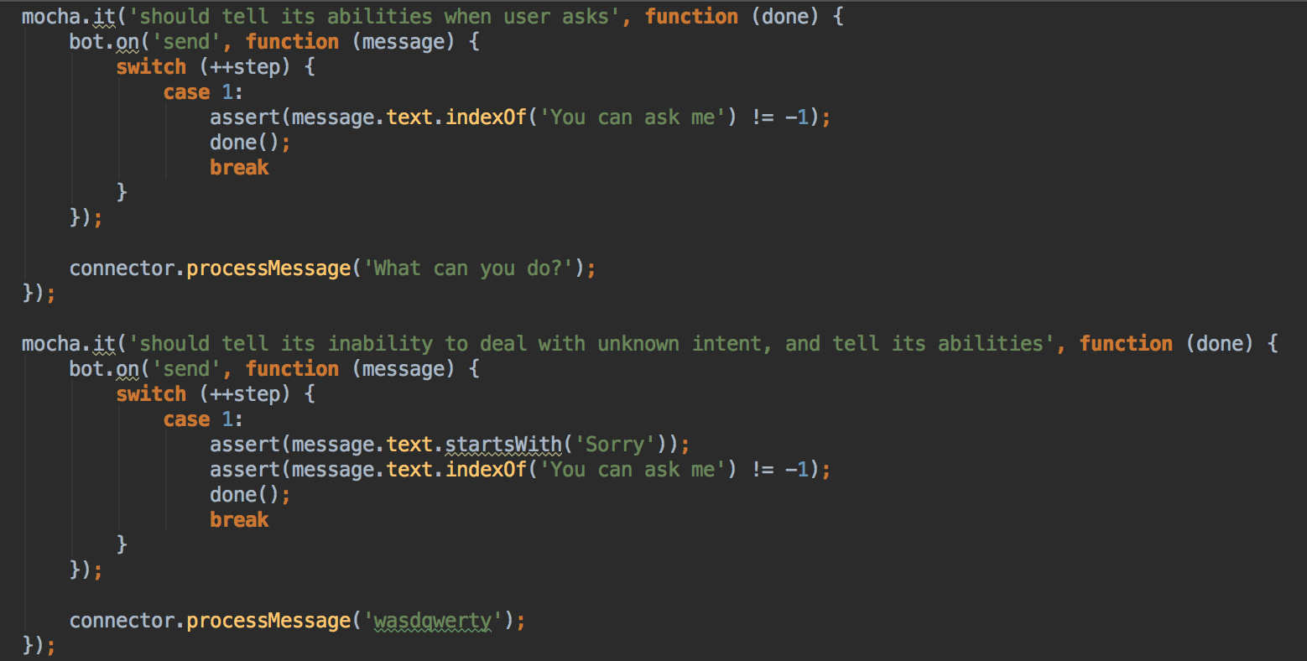
Test cases
Notes:
Yun

Slide 9
Problems
User authentication blocks
Jira ”assign to me”
may give up cookie based OAuth
Notes:
Yun

Slide 10
Future (some already done)
Cookie based authentication
web interface for first time log in
mongodb for storing cookies
Add more rules to LUIS to be more powerful
add proiroty, add to sprint, add to assignee,
Fuzzy search - return best match
use open source library that calculate document distance
Finalize react programming (let user know what bot is doing)
searching, typing, reporting progress, estimating time to finish
More features to be added: to be more scalable and fast
Notes:
Young

